Slide 1

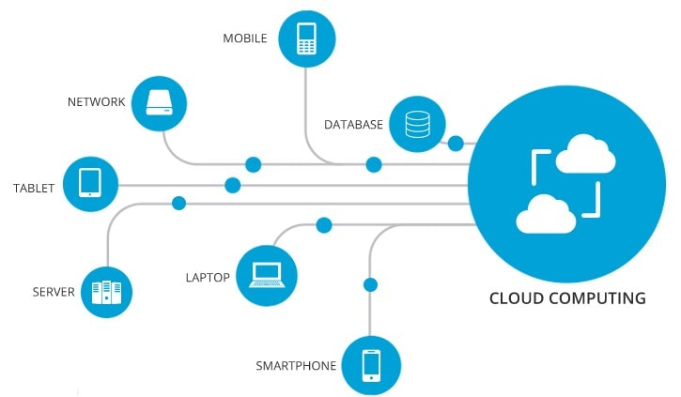


Module 1: Introduction
Cloud Computing & Virtualization

Slide 2
Outline
Historical Developments
NIST definition
Essential Characteristics
Advantages and Disadvantages
Cloud Servies (SaaS, IaaS, PaaS)
Computing Platforms and Technologies - Microsoft Azure, Hadoop, Force.com and Salesforce.com, Manjrasoft Aneka
3

Slide 3
Daily Life Examples
3

Slide 4
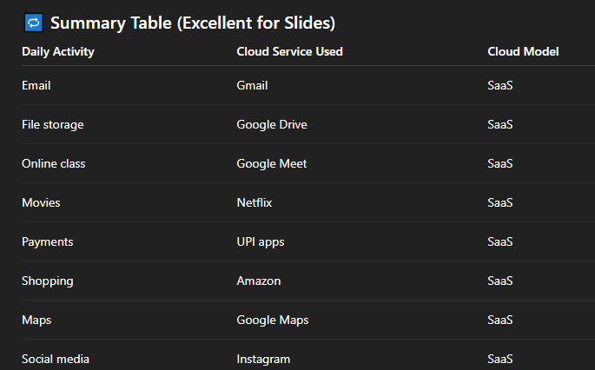

Slide 5
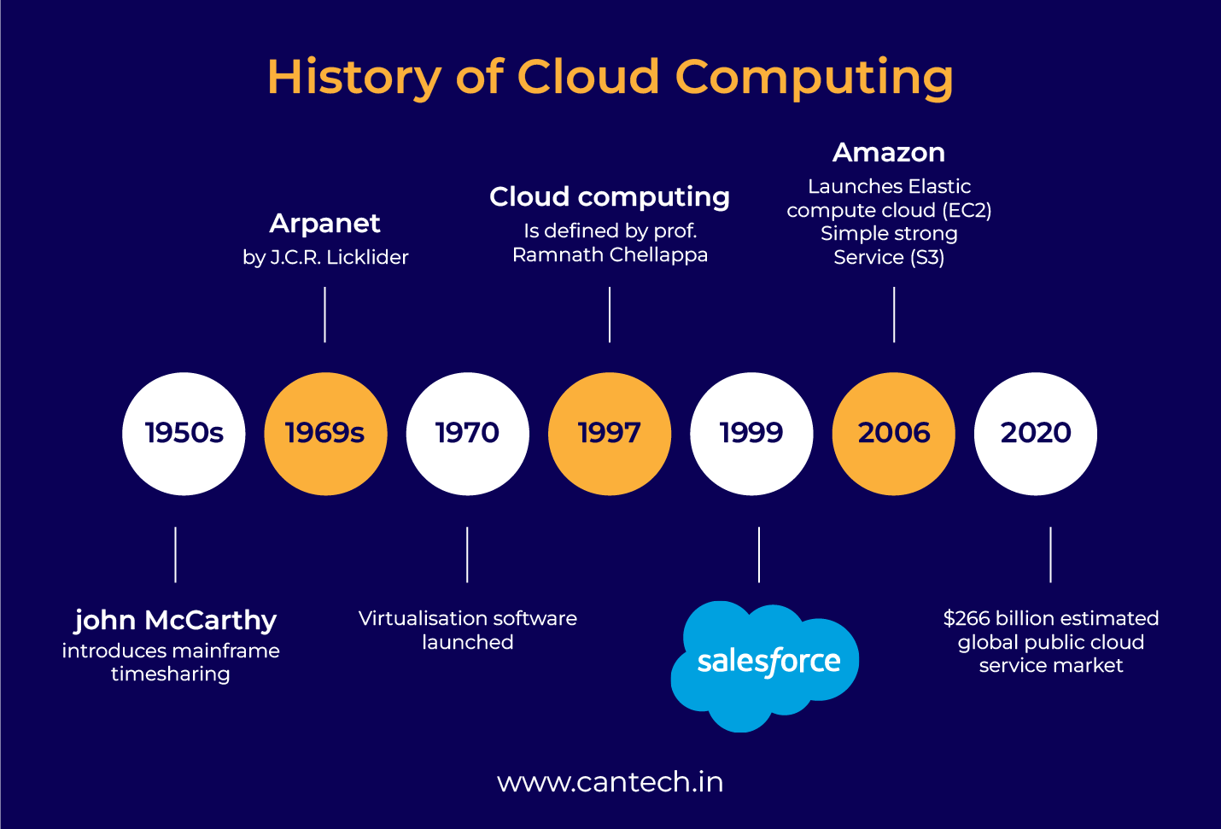
3
Notes:
1950 – one mainframe, multiple users/terminals could do their processing
1960 ARPANET (Advanced Research Projects Agency Network)- multiple users could access hosted applications
1970- virtual machines on single system, multiple OS
1990- Virtual Private Network- VPN is a networking and security technology that is commonly used to secure access to cloud and on-premise resources, but VPN itself is not cloud computing.
In 1997, one of the first definitions of cloud computing came from Professor Ramnath Chellapa of Emory University and the University of South California. He referred to cloud computing as the “computing paradigm where the boundaries of computing will be determined by economic rationale rather than technical limits alone.”

Slide 6
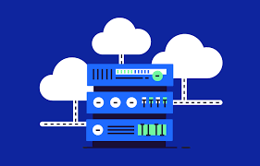
2. US National Institute of Standards and Technology (NIST) definition
Cloud computing is a model for enabling ubiquitous, convenient, on-demand network access to a shared pool of configurable computing resources (e.g. networks, servers, storage, applications, and services) that can be rapidly provisioned and released with minimal management effort or service provider interaction.
3

Slide 7
2. US National Institute of Standards and Technology (NIST) definition
ubiquitous
on-demand network access
networks
servers
storage
applications
services
provisioned and released
3
Notes:
1. Ubiquitous – anytime anywhere from home, office
2. On-demand- whenever you ask for it you get it, no extra steps/installations required
3. Networks- connectivity infrastructure
In cloud context:
Internet
Routers
Switches
Firewalls
Load balancers
Your device → Internet → Google data center
4. Servers-Powerful computers that run continuously – located in cloud data centers
5. Storage- n cloud context:
Files
Emails
Photos
Databases
Backups
Stored:
Remotely
6. Applications- Gmail, Zoom, Canva – installing app on your machine doesn’t make it non-clud, you simply install client on your machine and real work happens at servers
7. Services- ready to use It functionalities like storage, softwares
8. Provisioned and released- given when required, taken back when not required

Slide 8
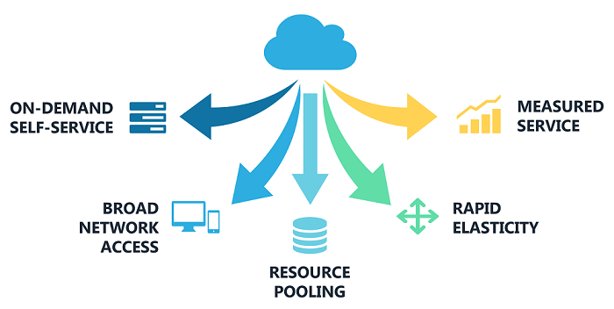
3. Essential Characteristics
3

Slide 9
3. Essential Characteristics
3.1 On Demand Self Service
Pay-per-use pricing
Rent out computer resources based on consumer demand
Anything that includes providing hosted services via the internet
Eliminates the need for hardware acquisition, upkeep, and upgrades
Flexibility to meet fluctuating demands
Cut costs
Example- On Netflix, when users start watching, cloud servers scale instantly during peak hours, more servers are allocated automatically
Salesforce- Company subscribes to CRM instantly, No installation or server setup, Users added or removed anytime
Google drive
3

Slide 10
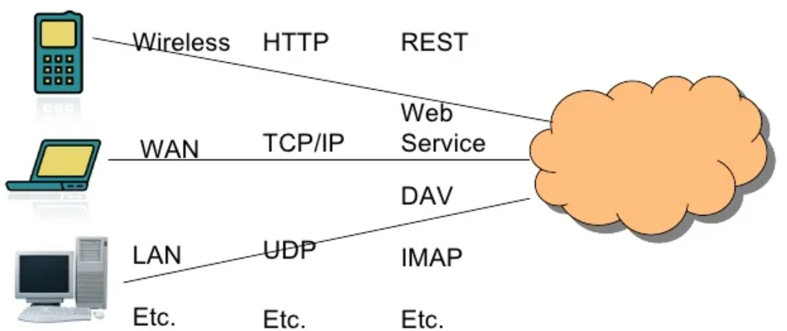
3. Essential Characteristics
3.2 Broad Network Access
Cloud services can be accessed via the internet using a variety of devices (laptops, desktops, tablets, and smartphones) from any location in the globe.
3

Slide 11
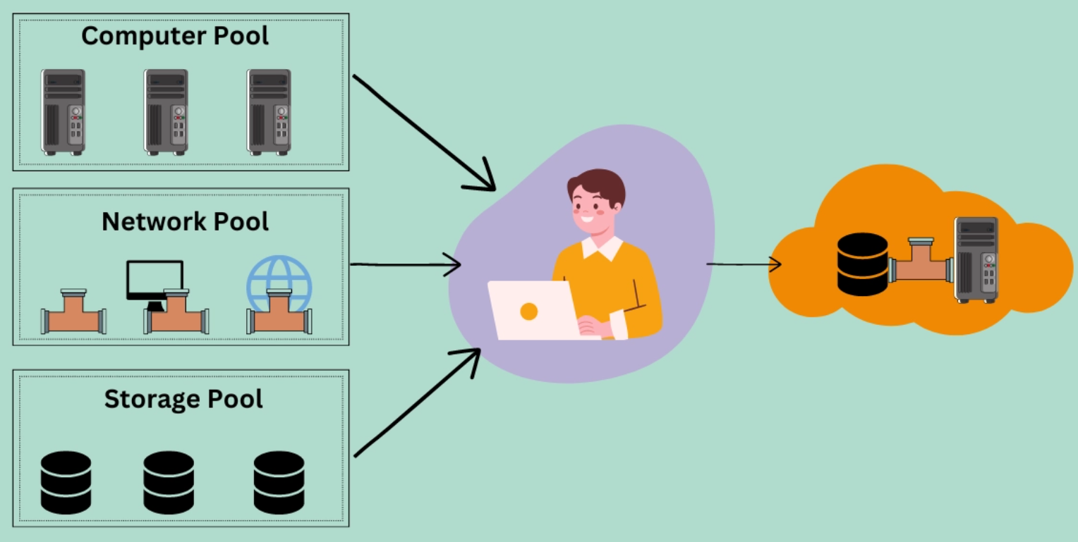
3. Essential Characteristics
3.3 Resource Pooling
Resource pool is a group of resources that can be assigned to users. Resources of any kind, including computation, network, and storage, can be pooled.
Resources are dynamically provided according to need rather than being permanently allocated to users.
3

Slide 12
In cloud computing, end users interact with applications rather than individual instances; instances are backend virtual machines that can serve multiple users and are allocated multiple computing resources.

Slide 13
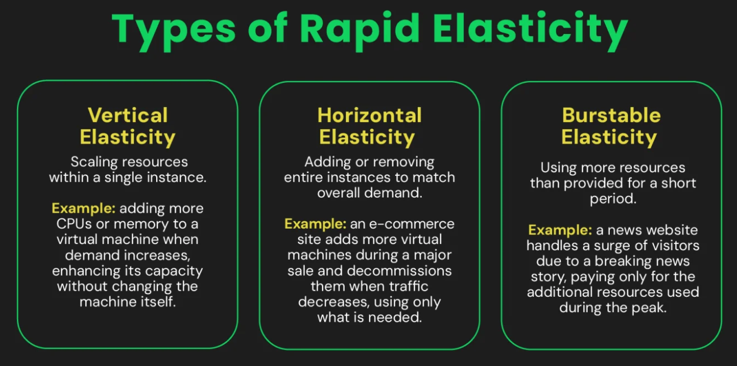
3. Essential Characteristics
3.4 Rapid Elasticity
3
Notes:
End user usage patterns or pricing tier influence burstable elasticity

Slide 14
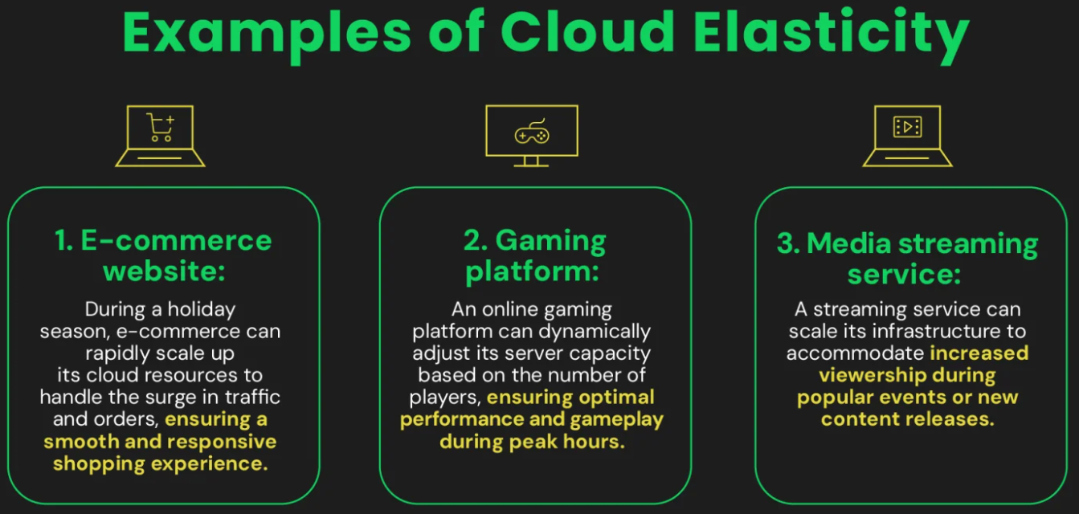
3. Essential Characteristics
3.4 Rapid Elasticity
3

Slide 15
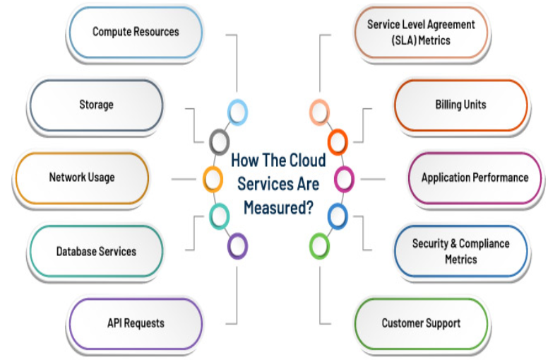
3. Essential Characteristics
3.5 Measured Service
3
Notes:
SLA - A formal agreement between a cloud provider and a customer that defines how good the service must be –EXAMPLE - How often the service is up and running,, DOWNTIME ALLOWED TIME
Billing Units- Billing Units
What is measured?
Units like hours, GB, requests, users
Why measured?
Converts usage into cost
Example: ₹ per VM-hour, ₹ per GB stored
3. Application performance- What is measured?
Response time
Throughput
Error rate
4. Security & Compliance metrics- Audit logs, ISO / GDPR compliance reports

Slide 16
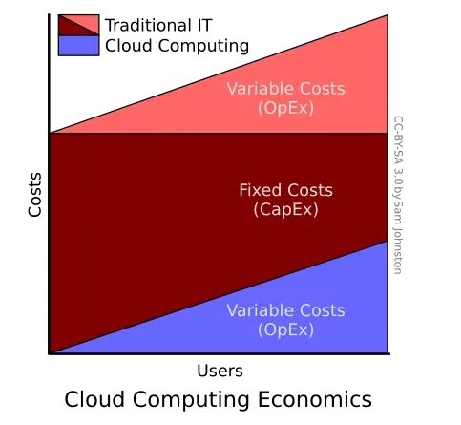
4. Cost Model
3

Slide 17
4. Cost Model
TRADITIONAL
Users must acquire their own computer and peripheral equipment as capital expenses.
Operational expenditures- (Power & cooling)
maintaining the computer systems, including personnel and service costs.
operational costs increase sharply with a larger number of users.
CLOUD COMPUTING
Cloud computing applies a pay-per-use business model, in which user jobs are outsourced to data centers.
To use the cloud, one has no up-front cost in hardware acquisitions.
Only variable costs are experienced by cloud users
3

Slide 18
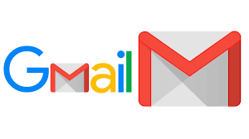

Is this Cloud or not ?
Accessing College ERP software through VPN

Slide 19
Match the Cloud Characteristics
A cloud user is billed only for the number of GB stored and the hours of virtual machine usage.
Multiple users from different colleges store files on the same cloud platform, but each user’s data remains isolated.
During online exam registration, the system automatically adds more servers to handle increased traffic and removes them afterward.
student creates a Google Drive folder instantly without contacting IT staff.
A faculty member accesses the same cloud document from a mobile phone, laptop, and lab computer.
On-Demand Self-Service
Broad Network Access
Resource Pooling
Rapid Elasticity
Measured Service

Slide 20
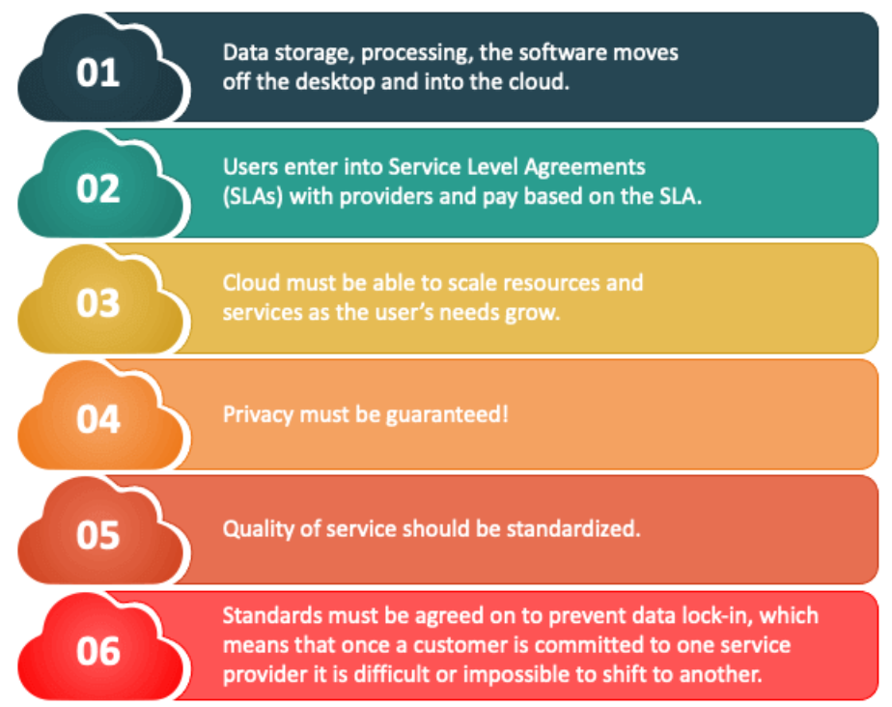
5. Cloud Design Objectives

Slide 21
https://www.masterborn.com/blog/cloud-vendor-lock-in-4-real-life-scenarios-and-lessons-learned

Slide 22
Role Play- Cloud Provider vs Cloud User
Questions asked by Group A:
Questions asked by Group B:
Groups
Group A → Cloud Provider
Group B → College (Cloud User)

Slide 23
6. Cloud Computing Advantages
Notes:
Cost
Processing power
Storage
No update worry
Compatibility of documents
Collaboration
independence

Slide 24
5. Cloud Computing Advantages
Lower computer costs:
No need of a high-powered and high-priced computer to run cloud computing's web-based applications.
Since applications run in the cloud, not on the desktop PC, your desktop PC does not need the processing power or hard disk space demanded by traditional desktop software.
When you are using web-based applications, your PC can be less expensive, with a smaller hard disk, less memory, more efficient processor
PC in this scenario does not even need a CD or DVD drive, as no software programs have to be loaded and no document files need to be saved.

Slide 25
5. Cloud Computing Advantages
2. Improved performance:
With few large programs hogging your computer's memory, you will see better performance from your PC.
Computers in a cloud computing system boot and run faster because they have fewer programs and processes loaded into memory.
3. Reduced software costs:
Instead of purchasing expensive software applications, you can get most of what you need for free.
4. Improved document format compatibility.
–You do not have to worry about the documents you create on your machine being compatible with other users' applications or OS.
–There are less format incompatibilities when everyone is sharing documents and applications in the cloud.

Slide 26
5. Cloud Computing Advantages
5. Instant software updates
No longer faced with choosing between obsolete software and high upgrade costs.
When the application is web-based, updates happen automatically available the next time you log into the cloud.
When you access a web-based application, you get the latest version without needing to pay for or download an upgrade.
6. Unlimited storage capacity
Cloud computing offers virtually limitless storage.
Your computer's current 1 Tera Bytes hard drive is small compared to the hundreds of Peta Bytes available in the cloud.

Slide 27
5. Cloud Computing Advantages
7. Increased data reliability
Unlike desktop computing, in which if a hard disk crashes and destroy all your valuable data, a computer crashing in the cloud should not affect the storage of your data.
If your personal computer crashes, all your data is still out there in the cloud, still accessible
8. Universal information access
access your work whenever you have a computer and an Internet connection
9. Easier group collaboration
10. Device independence
You are no longer tethered to a single computer or network.

Slide 28
6. Cloud Computing Disadvantages
.

Slide 29
6. Cloud Computing Disadvantages
Requires a constant internet connection
Cloud computing is impossible if you cannot connect to the Internet.
2. Does not work well with low-speed connections
Web-based applications require a lot of bandwidth to download, as do large documents.
3. Features might be limited
Many web-based applications simply are not as full-featured as their desktop-based applications.
Example- you can do a lot more with Microsoft PowerPoint than with Google Presentation's web-based offering
4. Stored data might not be secured
5. Stored data can be lost!

Slide 30
6. Cloud Computing Disadvantages
6. HPC Systems
Running compute-intensive HPC applications that use MPI/OpenMPI can be difficult sometimes
Scheduling is important with this type of application as you want all the VM to be co-located to minimize communication latency!
7. General Concerns
Each cloud systems uses different protocols and different APIs
may not be possible to run applications between cloud based systems
Amazon has created its own DB system (not SQL 92), and workflow system (many popular workflow systems out there) so your normal applications will have to be adapted to execute on these platforms.
Notes:
Applications tightly coupled to a cloud provider’s services may not be portable across different cloud platforms.
MPI- Message Passing Interface

Slide 31
7. Service Models
What are Cloud Service Models?
Cloud service models define the control, management, and abstraction level you have when utilizing cloud services.
They determine the type of services available, how much infrastructure you manage, and what level of responsibility the cloud provider assumes.
The primary goal of these models is to enable scalability, flexibility, and cost-effectiveness, which allows you to focus on what matters most: development and innovation.

Slide 32
6.1 Service Models- SAAS
SaaS is defined as software that is deployed over the internet.
With SaaS, a provider licenses an application to customers
a service on demand.
Either through a subscription, in a “pay-as-you-go” model, or
(increasingly) at no charge when there is opportunity to generate revenue from streams other than the user, such as from advertisement or user list sales.
Examples: Sales Force Customer Relationship Management (CRM) software

Slide 33
Applications where SaaS is used
Applications where there is significant interplay between organization and outside world. Example: email newsletter campaign software
Applications that have need for web or mobile access. E.g. mobile sales management software.
Software that is only to be used for a short term need.
Software where demand spikes significantly. E.g. Tax/Billing softwares.
Notes:
email newsletter campaign software- Sending thousands/millions of emails, Tracking opens, clicks, unsubscribes, Integrating with customer databases, websites, CRM tools
Why cloud fits best
🌍 Global reach – emails can be sent worldwide from cloud data centers
📈 Scalability – campaign size may vary (100 emails today, 1 million tomorrow)
🔄 High availability – downtime directly affects business reputation
Mobile sales management software- Employees or users access the application using:
Mobile phones
Tablets
Web browsers from any location
Example:
Salesperson updates leads from client location
Manager checks sales dashboard while travelling
Software needed only for a short term- Example: Event registration system, election portals, exam result portals
Pay-as-you-go – no long-term hardware investment
Quick deployment – can be set up in hours Easy teardown – resources released after use No maintenance overhead after project ends

Slide 34
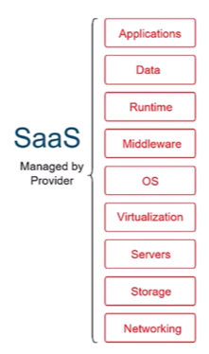

Slide 35
Service Models- Analogy
IAAS (Infrastructure As A Service)
PAAS (Platform As A Service)
SAAS (Software As A Service)
Eat Pasta ?
A. Buying pre-packed ingredients like fresh pasta and sauce made by someone else that you use to cook at home.
B. Order takeout or delivery where your meal is prepared for you and you don’t have to worry about the ingredients or how you’ll cook it, but you have to worry about where you’ll eat, the utensils, and cleaning up after your meal.
C. Call ahead to the restaurant and order the exact meal you want. They prepare everything ahead of time for you so that all you have to do is show up and eat.
Notes:
https://cloud.google.com/discover/types-of-cloud-computing
C
uying ingredients & cooking at home → IaaS
What you do
Buy raw ingredients
Cook yourself
Decide recipe, timing, tools
Clean everything
Cloud analogy
You get virtual machines
You install OS, runtime, software
You manage everything above hardware
✔️ Maximum control → IaaS

Slide 36
6.2 Platform as a Service (PaaS)
PaaS can be defined as a computing platform that allows creation of web applications quickly and easily and without the complexity of buying and maintaining the software and infrastructure underneath it.
Rather than being software delivered over the web, it is a platform for the creation of software, delivered over the web.
PaaS Examples: Microsoft Azure, Google App Engine
Notes:
App Engine makes it easier to develop scalable and high-performance Web apps

Slide 37
Scenarios where PaaS is used
PaaS is especially useful in any situation where multiple developers will be working on a development project
Or where other external parties need to interact with the development process.
PaaS is useful where developers wish to automate testing and deployment services.
The popularity of agile software development- iterative and incremental development has increased the uptake of PaaS

Slide 38
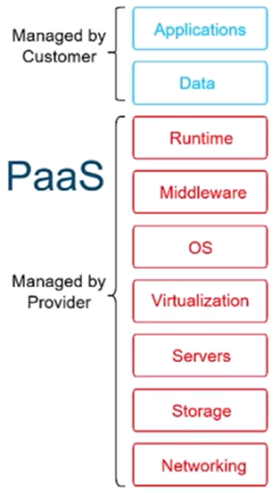

Slide 39
Service Models- Analogy
IAAS (Infrastructure As A Service)
PAAS (Platform As A Service)
SAAS (Software As A Service)
Eat Pasta ?
1. Buying pre-packed ingredients like fresh pasta and sauce made by someone else that you use to cook at home.
2. Order takeout or delivery where your meal is prepared for you and you don’t have to worry about the ingredients or how you’ll cook it, but you have to worry about where you’ll eat, the utensils, and cleaning up after your meal.
3. Call ahead to the restaurant and order the exact meal you want. They prepare everything ahead of time for you so that all you have to do is show up and eat.
Notes:
https://cloud.google.com/discover/types-of-cloud-computing
2
Ordering takeaway / delivery → PaaS
What you don’t do
Don’t cook
Don’t worry about ingredients
What you still manage
Where to eat
Utensils
Cleaning after eating
Cloud analogy
Platform (OS, runtime) is managed
You focus on your application
Limited control, but flexibility remains
✔️ Balanced abstraction → PaaS

Slide 40
Scenarios where PaaS is not ideal
Where proprietary languages or approaches would impact on the development process
Where a proprietary language would hinder later moves to another provider – concerns are raised about vendor lock in
Where application performance requires customization of the underlying hardware and software
Notes:
If the PaaS platform dictates how you must code, it may negatively affect the development process.- LEAD TO VENDOR LOCKIN
High-frequency trading systems, Scientific simulations, Gaming engines with tight latency requirements- When performance depends on hardware or OS customization, PaaS is too restrictive.

Slide 41
6.3 Infrastructure as a Service (IaaS)
Infrastructure as a Service (IaaS) is a way of delivering Cloud Computing infrastructure – servers, storage, network and operating systems – as an on-demand service.
Rather than purchasing servers, software, datacenter space or
network equipment, clients instead buy those resources as a fully outsourced service on demand.

Slide 42
Scenarios where IaaS makes sense
Where demand is very volatile – any time there are significant spikes and troughs in terms of demand on the infrastructure
For new organizations without the capital to invest in hardware
Where the organization is growing rapidly and scaling hardware would be problematic
Where there is pressure on the organization to limit capital expenditure and to move to operating expenditure
For specific line of business, trial or temporary infrastructural needs

Slide 43
Scenarios where IaaS may not be the best option
Where regulatory compliance makes the offshoring or outsourcing of data storage and processing difficult.
Where the highest levels of performance are required, and on-premise or dedicated hosted infrastructure has the capacity to meet the organization’s needs

Slide 44
Service Models- Analogy
IAAS (Infrastructure As A Service)
PAAS (Platform As A Service)
SAAS (Software As A Service)
Eat Pasta ?
1. Buying pre-packed ingredients like fresh pasta and sauce made by someone else that you use to cook at home.
2. Order takeout or delivery where your meal is prepared for you and you don’t have to worry about the ingredients or how you’ll cook it, but you have to worry about where you’ll eat, the utensils, and cleaning up after your meal.
3. Call ahead to the restaurant and order the exact meal you want. They prepare everything ahead of time for you so that all you have to do is show up and eat.
Notes:
https://cloud.google.com/discover/types-of-cloud-computing
1
Going to restaurant & eating → SaaS
What you do
Just show up
Eat
What you don’t worry about
Ingredients
Cooking
Cleaning
Infrastructure
Cloud analogy
Software fully managed
You only use the service

Slide 45
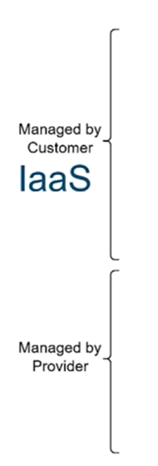
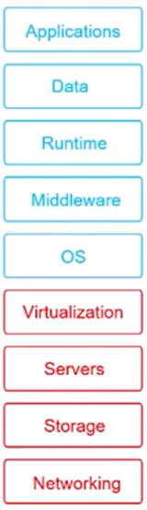

Slide 46
Service Models Differences

Slide 47
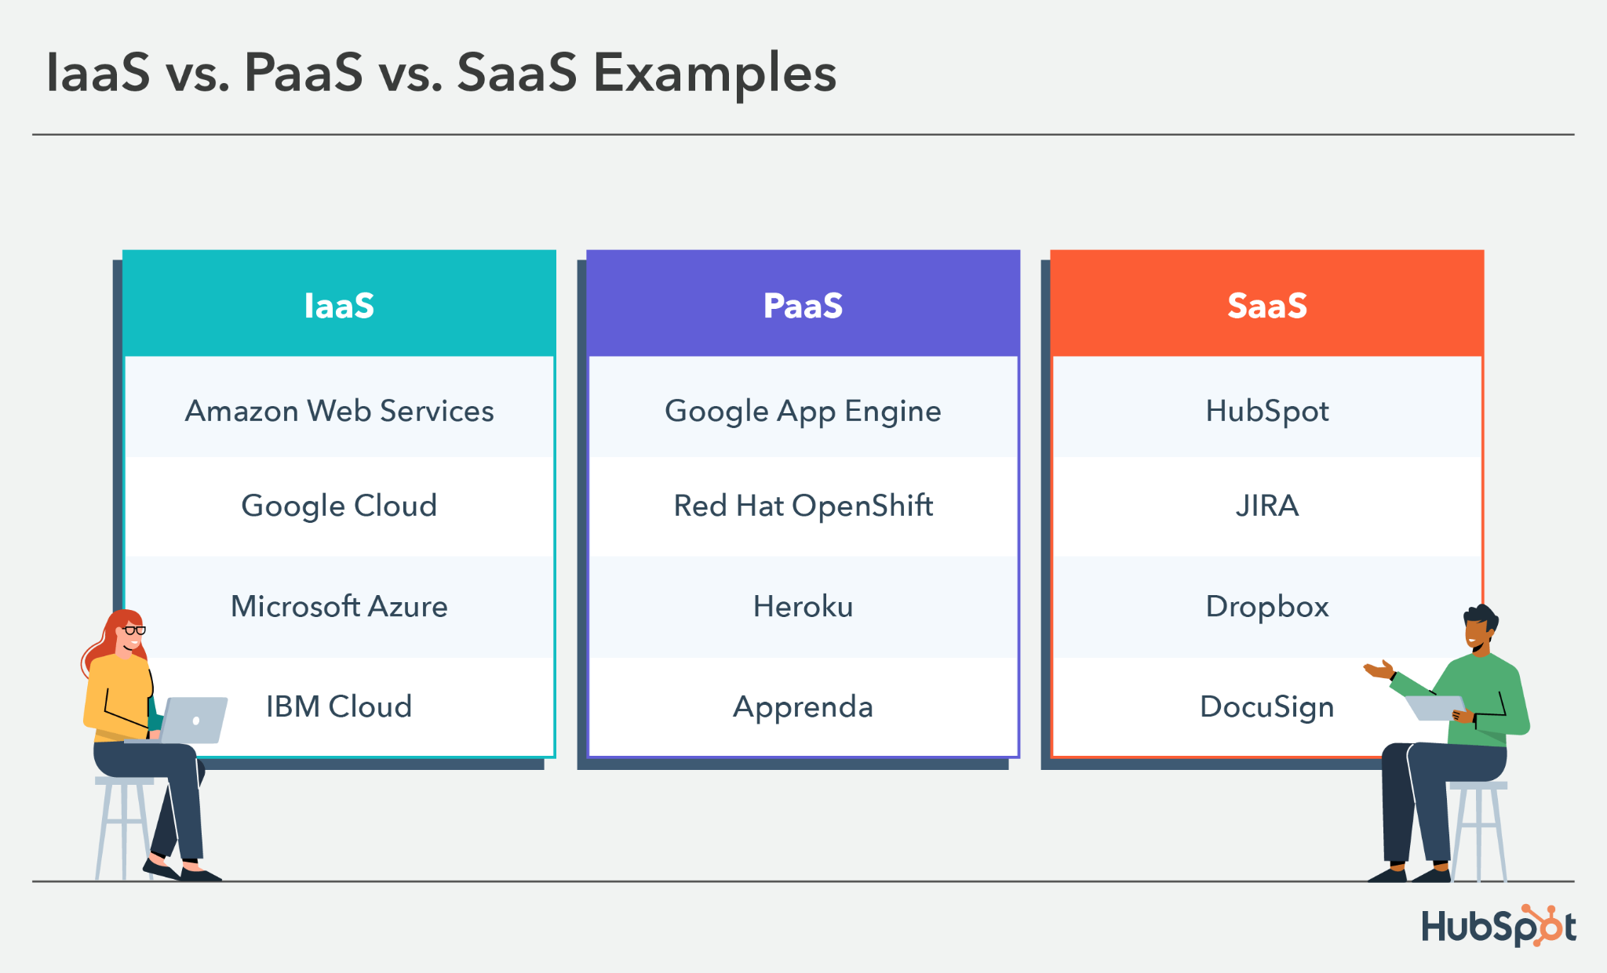

Slide 48
Applications like Spotify, social media platforms, Swiggy, and Uber are examples of SaaS for end users, while their backend systems are built using PaaS and IaaS.

Slide 49
Service Models (XaaS)
Most common examples of XaaS are
Software as a Service (SaaS)
Platform as a Service (PaaS)
Infrastructure as a Service (IaaS)
Other examples of XaaS include
Business Process as a Service (BPaaS)
Storage as a service (another SaaS)
Security as a service (SECaaS)
Database as a service (DaaS)
Monitoring/management as a service (MaaS)
Communications, content and computing as a service (CaaS)
Identity as a service (IDaaS)
Backup as a service (BaaS)
Desktop as a service (DaaS)

Slide 50
Service Models (XaaS)
X as a Service (XaaS) is a generalization for cloud-related services
XaaS stands for "anything as a service" or "everything as a service“
XaaS refers to an increasing number of services that are delivered over the Internet rather than provided locally or on-site

Slide 51
KNOWLEDGE CHECK
Q1. A student writes Java code on an online compiler and clicks Run. Which cloud service model is being used?
a) SaaS
b) PaaS
c) IaaS
d) FaaS
Q2. A system administrator launches a virtual machine and installs an OS and database manually. This is an example of:
a) SaaS
b) PaaS
c) IaaS
d) DaaS
Notes:
Paas
Iaas

Slide 52
KNOWLEDGE CHECK
Q3. Spotify is classified as SaaS because:
a) It uses cloud servers
b) It uses databases
c) End users consume the software directly
d) It uses APIs
Q4. In PaaS, which of the following is NOT managed by the user?
a) Application code
b) Configuration settings
c) Runtime and OS
d) Business logic
Notes:
3. c
4. c

Slide 53
KNOWLEDGE CHECK
Q5. Which scenario is NOT suitable for PaaS?
a) Rapid application development
b) Auto-scaling web apps
c) Hardware-level performance tuning
d) API-based applications
Notes:
5. c

Slide 54
KNOWLEDGE CHECK
Task:
Classify the following as SaaS, PaaS, or IaaS:
Gmail
Google Colab
Online Java compiler
AWS EC2
Running OS on VM
Notes:
Scenario
Model
Gmail
SaaS
Google Colab
PaaS
Online Java compiler
PaaS
AWS EC2
IaaS
Running OS on VM
IaaS

Slide 55
7. Cloud Deployment Models
Cloud deployment models (Public, Private, Hybrid) define where and who owns/manages the cloud infrastructure
while IaaS, PaaS, and SaaS (Service Models) define what services you get and how much control you have over them
The cloud deployment model identifies the specific type of cloud environment based on ownership, scale, and access, as well as the cloud's nature and purpose.
The location of the servers you're utilizing and who controls them are defined by a cloud deployment model.
It specifies how your cloud infrastructure will look, what you can change, and whether you will be given services or will have to create everything yourself

Slide 56
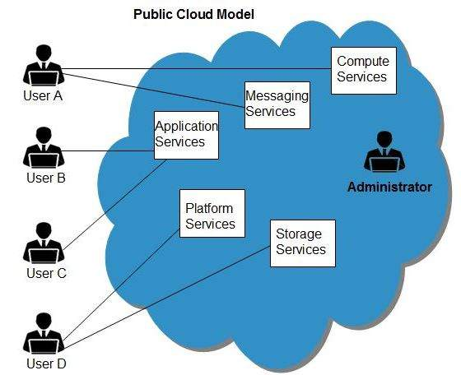
7.1 Cloud Deployment Model- Public Model
Cloud services provider owns the infrastructure and openly provides access to it for the public to consume.
The service provider owns the hardware and supporting networking infrastructure, which is under its full control.
The service provider is responsible for the physical security, maintenance, and management of the data center where the infrastructure resides.

Slide 57
7.1 Cloud Deployment Model- Public Model
The underlying infrastructure is outside of the customer’s control and away from the customer’s physical location.
The cloud service provider will share infrastructure between multiple customers whilst keeping data separate and isolated
Cloud providers go to great lengths to ensure that physical data centers are extremely secure and highly regulated environments,
Infrastructure is managed primarily using a web browser, but can also be manipulated using an API, on the command line, or using infrastructure-as-code tools such as Terraform.

Slide 58
7.1 Cloud Deployment Model- Public Model
It may be owned, managed, and operated by a business, academic, or government organization, or some combination of them.
It exists on the premises of the cloud provider.
In Public setting, the provider's computing and storage resources are potentially large;
the communication links can be assumed to be implemented over the public Internet
Commonly used public clouds include Microsoft Azure, Amazon AWS, Google Cloud, Oracle Cloud, and Alibaba Cloud.

Slide 59
7.1 Cloud Deployment Model- Public Model
Advantages of the public cloud model
Scalability: Resources can be scaled up or down instantly to match workload demands
Cost efficiency: Pay-as-you-go pricing reduces upfront capital expenses and aligns costs with actual usage
Reduced management overhead: The provider handles maintenance, updates, and infrastructure reliability
Rapid deployment: New environments and applications can be provisioned in minutes.
Global availability: Data centers across regions improve performance and support international operations
Flexibility: Ideal for variable workloads, testing environments, and disaster recovery solutions

Slide 60
7.1 Cloud Deployment Model- Public Model
Disadvantages of the public cloud model
Security concerns: Shared infrastructure increases exposure to risks, requiring strict compliance and data protection measures
Limited control: Organizations have less visibility and customization compared to private or on-premises environments
Unpredictable costs: Usage-based billing can lead to unexpectedly high expenses if workloads are not carefully monitored

Slide 61
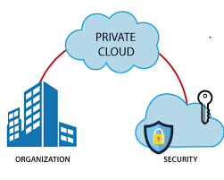
7.2 Cloud Deployment Model- Private Model
The cloud infrastructure is provisioned for exclusive use by a single organization comprising multiple consumers (e.g., business units).
It may be owned, managed, and operated by the organization, a third party, or some combination of them, and it may exist on or off premises.
Examples of Private Cloud: Eucalyptus, Ubuntu Enterprise Cloud - UEC , Amazon VPC (Virtual Private Cloud) , VMware Cloud Infrastructure Suite, Microsoft ECI data center.

Slide 62
7.2 Cloud Deployment Model- Private Model
Environment and computing resources are exclusively dedicated to a single customer.
As a single-tenant infrastructure, it is comparable to owning a data center in a company, but it allows scaling services on demand thanks to virtualization.
Private cloud solutions offer greater security and control to companies, as they do not have to share their resources with other customers.
Cloud performance is not affected by the activities of noisy neighbors.
Besides, by relying on a specialized private cloud provider, companies can completely forget about the management of physical servers.

Slide 63
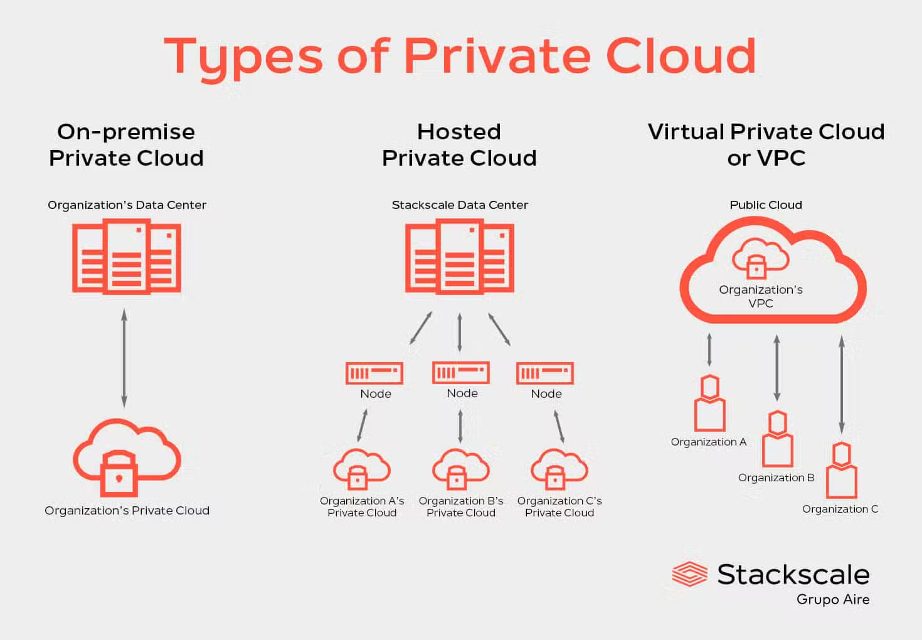

Slide 64
7.2 Cloud Deployment Model- Private Model
Advantages of the private cloud model:
Enhanced security: Dedicated infrastructure reduces risks associated with multi-tenancy and supports strict compliance
Full control: Organizations manage configuration, resources, and policies to match specific business needs
Predictable performance: Resources are not shared with other tenants, ensuring consistent availability and reliability
Customization: Infrastructure and services can be tailored to unique workloads or legacy applications
Regulatory compliance: Easier to meet industry standards for data residency, privacy, and auditing

Slide 65
7.2 Cloud Deployment Model- Private Model
Disadvantages of the private cloud model:
High upfront cost: Significant investment is required for hardware, software, and data center infrastructure
Complex management: Organizations must handle maintenance, upgrades, and security internally, increasing operational burden
Limited scalability: Expanding capacity is slower and more expensive compared to the elasticity of public cloud services

Slide 66
7.3 Cloud Deployment Model- Community Model
Cloud infrastructure is provisioned for exclusive use by a specific community of consumers from organizations that have shared concerns e.g.
mission
security requirements
policy
compliance considerations
It may be owned, managed, and operated by one or more of the organizations in the community, a third party, or some combination of them
It may exist on or off premises.

Slide 67
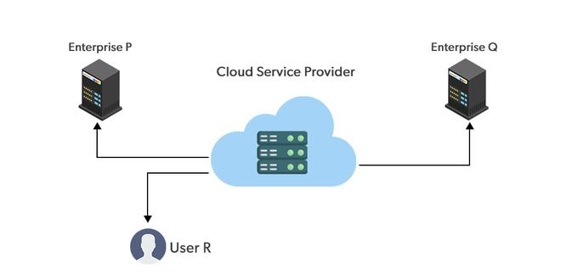
7.3 Cloud Deployment Model- Community Model

Slide 68
7.3 Cloud Deployment Model- Community Model
Advantages of the community cloud model
Shared costs: The community cloud model allows multiple organizations with similar requirements to share infrastructure, reducing individual expenses while maintaining higher security and compliance than the public cloud
Disadvantages of the community cloud model
Limited scalability: Resources are shared among a specific group, which can restrict expansion compared to public cloud options
Shared responsibility: Governance and security management require coordination among all members, which can lead to complexity or disputes
Not applicable to most SMEs (Small to Medium enterprises)

Slide 69
7.4 Cloud Deployment Model- Hybrid
The hybrid model combines both public and private cloud deployment models, giving a single cloud infrastructure that is aimed at increasing flexibility and deployment options for the business.
For example, applications with strict governance and data security requirements may be hosted in the business’s private cloud, whereas applications without these concerns, which need to be scaled on demand, could be hosted in the public cloud.

Slide 70
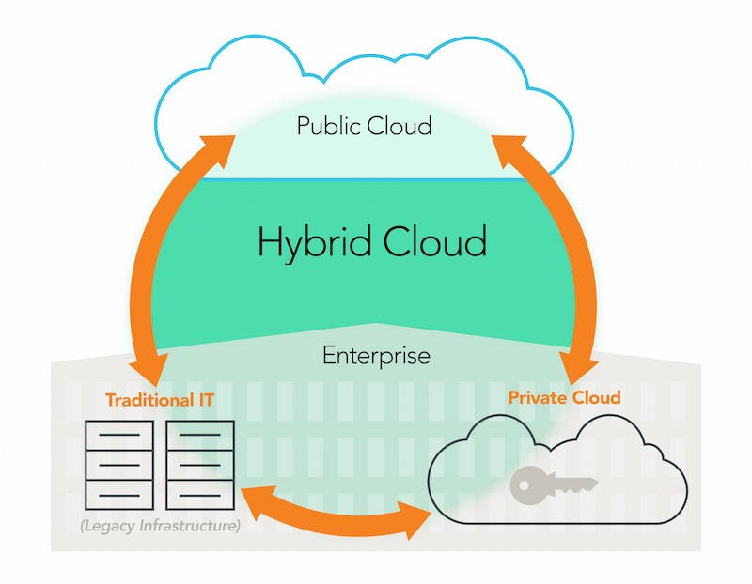
7.4 Cloud Deployment Model- Hybrid
Most businesses strive to alleviate the burden on the existing infrastructure by migrating to the public cloud where possible and effectively utilizing the hybrid deployment model during the migration period.

Slide 71
7.4 Cloud Deployment Model- Hybrid
Advantages of the hybrid cloud
Flexibility: Workloads can move between private and public environments depending on performance, security, or cost needs
Cost optimization: Sensitive data can remain on private infrastructure while variable workloads use the public cloud’s pay-as-you-go model
Scalability: Public cloud resources provide on-demand capacity during peak usage, reducing pressure on private infrastructure
Business continuity: Data and applications can be distributed across environments, improving disaster recovery and resilience

Slide 72
7.4 Cloud Deployment Model- Hybrid
Disadvantages of the hybrid cloud
Integration complexity: Managing interoperability between public and private environments requires advanced networking, security, and monitoring
Higher costs: Maintaining private infrastructure alongside public cloud services can increase overall expenses compared to a single model

Slide 73
7.5 Cloud Deployment Model- Multicloud
The multicloud deployment model usually refers to using multiple public cloud providers to increase flexibility and fault tolerance
After evaluation by the business, some services may be preferred on a certain cloud over another. For example, the GKE (Google Kubernetes Engine) hosted on the Google Cloud may be preferable over similar offerings on Azure, such as AKS (Azure Kubernetes Service) or Amazon EKS (Elastic Kubernetes Service). Workloads can be distributed selectively.

Slide 74
7.5 Cloud Deployment Model- Multicloud
Multicloud is also commonly used by businesses with critical workloads, such as government agencies or financial corporations.
Adopting multiple clouds gives development teams a choice from a much wider pool of options and can actually aid the developer workflow.
Some comparable services may be cheaper than others and so may also be preferable in certain scenarios. For example, AWS could be used for production, and Google Cloud could be used for testing.

Slide 75
7.5 Cloud Deployment Model- Multicloud
Advantages of the multicloud model:
Vendor independence: Reduces reliance on a single provider, avoiding lock-in and improving negotiation leverage
Resilience and availability: Workloads can be distributed across providers, minimizing downtime from regional or platform-specific failures
Optimized performance: Organizations can choose the best services from different providers to match specific workload requirements

Slide 76
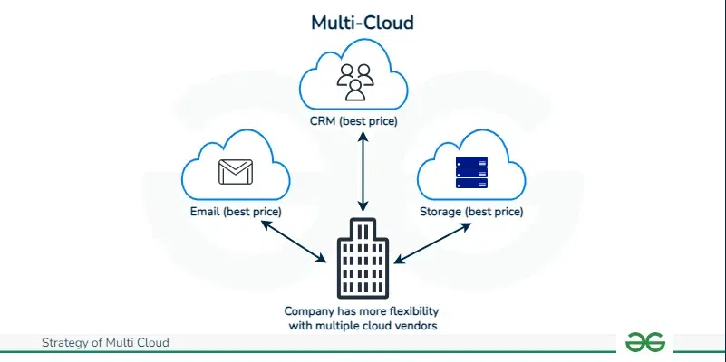
7.5 Cloud Deployment Model- Multicloud

Slide 77
7.5 Cloud Deployment Model- Multicloud
Disadvantages of the multicloud model:
Management complexity: Coordinating multiple providers requires advanced monitoring, governance, and integration tools
Increased costs: Duplicated services, data transfer fees, and specialized management can drive higher overall expenses

